Slide 1
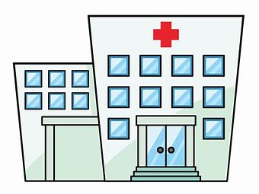
HOSPITAL MANAGEMENT SYSTEM
By-
Abhinav mukerji
Abhinn soni
Abhishek tyagi

Slide 2
OVERVIEW
Our project covers all the fundamental problems that may occur ina hospital management system, such as wrong entry, poor functionality, speed issues etc.
This system can be used in pathology labs, clinic, hospital , maintaining record of patient.
It incorporates nearly all the fundamental features required by the a hospital management .

Slide 3

Features
Useful for:
Large hospitals
Physicians, surgeons, gynecologists etc.
Data is successfully returned and the prescription is printed, if the data is found or is matched with the inner database.

Slide 4



Benefits
Minimizes Hand written data.
More reliable than traditional data management system.
Huge time saver ,communication among the management is improved.
Daily updation of the record.

Slide 5
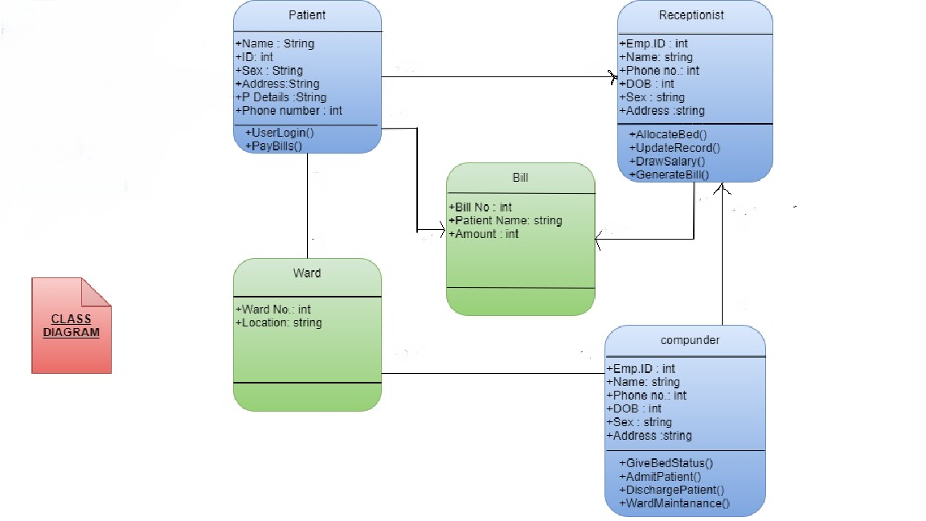
CLASS DIAGRAM

